Slide 1
Wine Quality Analysis
Presenter: Vishal Shailesh Pawar

Slide 2
Agenda
Review of Key Objectives & Critical Success Factors.
How did we do?
Organizational Overview
Top Issues Facing Company.
Review of and Progress Against Prior Goals.
Revenue and Profit.
Key Spending Areas.
Headcount
Goals for Next Period.

Slide 3
Problem Statement
Primary objective is to understand the factors contributing to its overall quality. With a dataset comprising 1599 observations and 12 independent variables, including acidity, sugar content, sulfur dioxide levels, and alcohol concentration.
We aim to investigate how these chemical components influence the wine's quality rating, which ranges from 0 to 10.
By identifying the key contributors to wine quality, we strive to provide insights that can assist winemakers in enhancing their production processes and crafting superior-quality wines.

Slide 4
Data Collection
Kaggle link: https://www.kaggle.com/datasets/yasserh/wine-quality-datasetWe aim to investigate how these chemical components influence the wine's quality rating, which ranges from 0 to 10.
This dataset pertains to red variations of Portuguese "Vinho Verde" wine. It contains information about the quantities of different chemicals found in the wine and how they influence its overall quality. The dataset can be approached as either a classification or regression task. However, it's important to note that the classes are ordered and not evenly distributed; for instance, there are more instances of normal-quality wines compared to excellent or poor ones.
Updation frequency: Annually

Slide 5
About Data
Description:
This dataset pertains to red variations of Portuguese “Vinho Verde” wine. It contains information about the quantities of different chemicals found in the wine and how they influence its overall quality. The dataset can be approached as either a classification or regression task. However, it’s important to note that the classes are ordered and not evenly distributed; for instance, there are more instances of normal-quality wines compared to excellent or poor ones.
Your objective is to use the provided data to predict the quality of wine. This project presents a straightforward yet demanding task: forecasting the quality of wine.
Number of Columns: 12
Number of Rows: 1599

Slide 6
About Data
Independent variables :
fixed acidity
volatile acidity
citric acid
residual sugar
chlorides
free sulfur dioxide
total sulfur dioxide
density
pH
sulphates
alcohol
Dependent variable :
quality (score between 0 and 10)

Slide 7
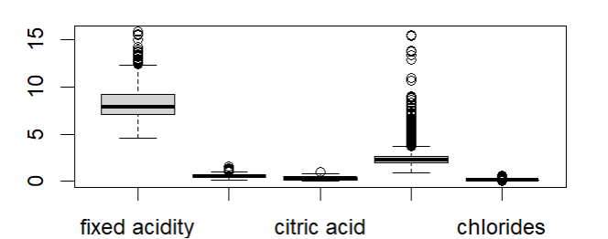
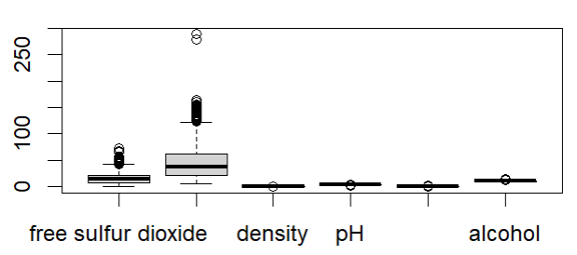
Exploratory Data Analysis
Univariate Analysis

Slide 8
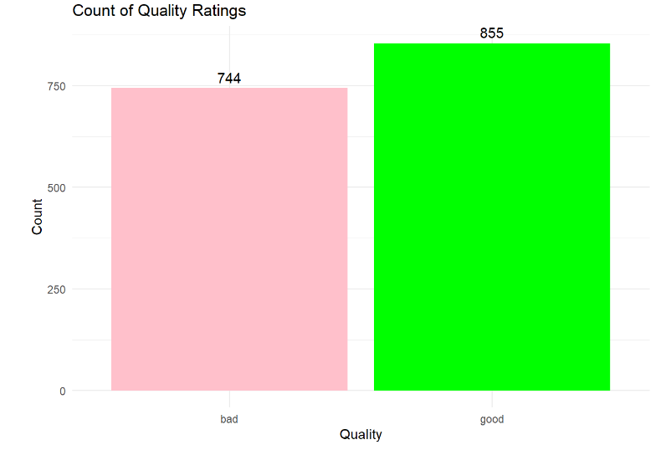
Exploratory Data Analysis
Dependent variable Analysis

Slide 9
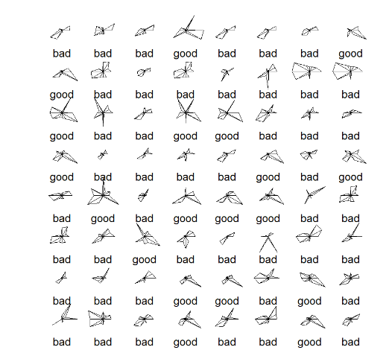
Exploratory Data Analysis
Multivariate Analysis

Slide 10
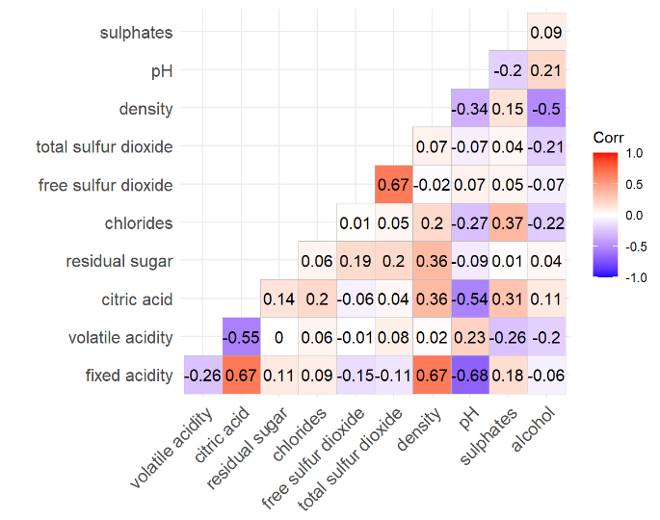
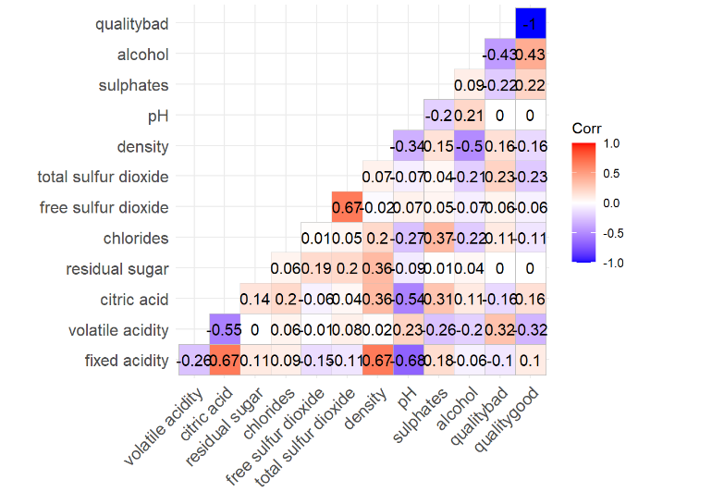
Exploratory Data Analysis
Multivariate Analysis: Correlation Plot

Slide 11
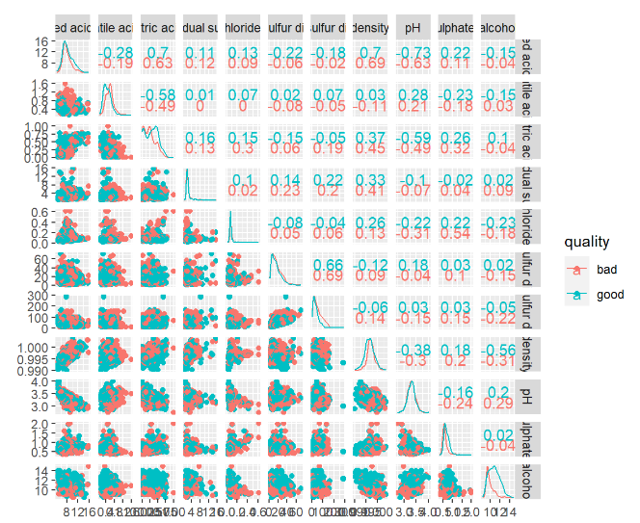
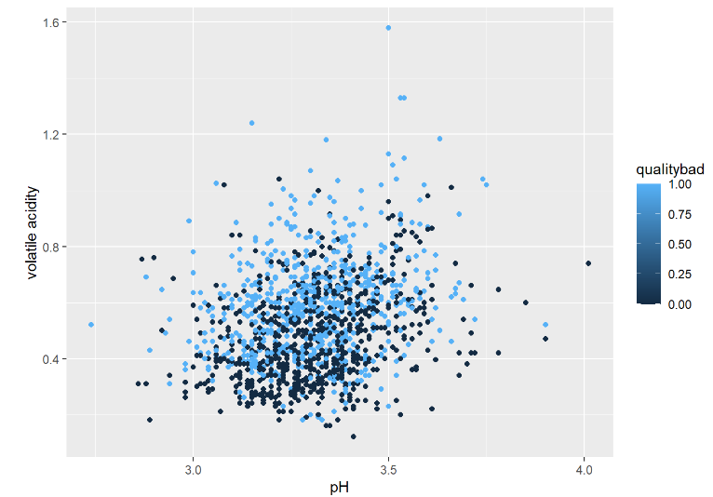
Exploratory Data Analysis
Multivariate Analysis: Correlation Plot

Slide 12
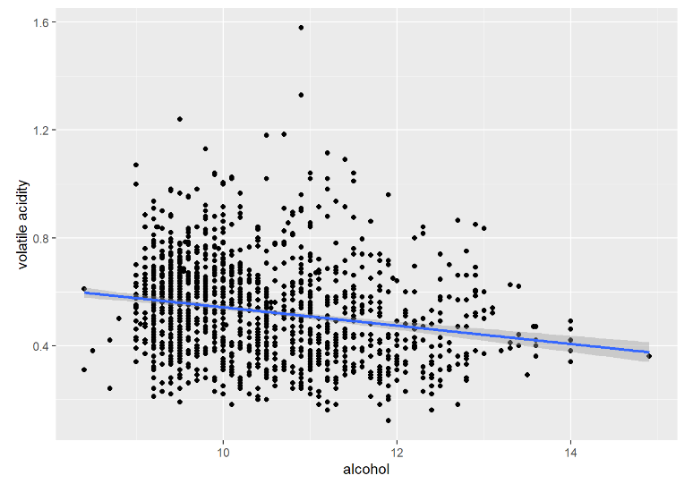
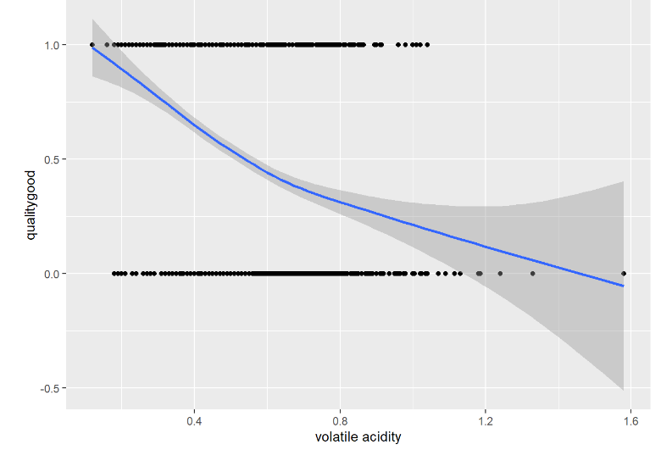
Exploratory Data Analysis
Multivariate Analysis: Correlation Plot

Slide 13
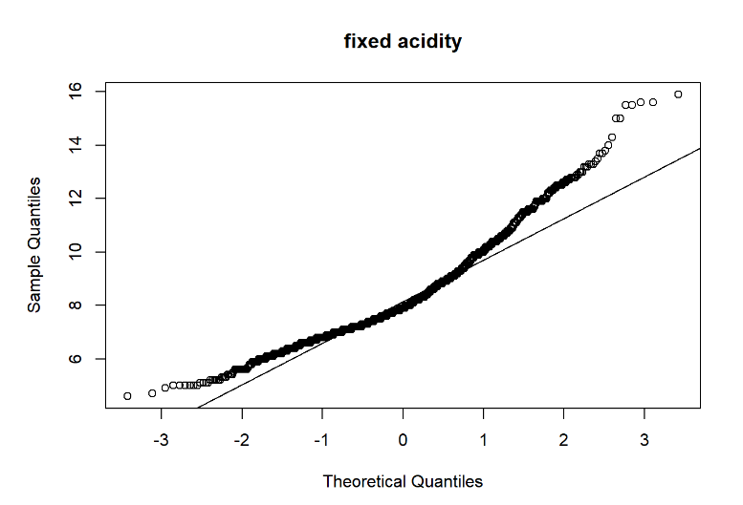
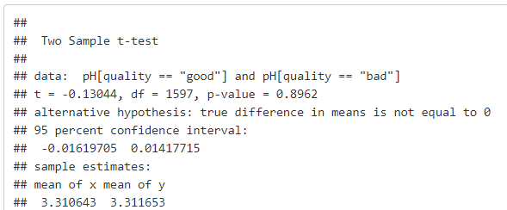
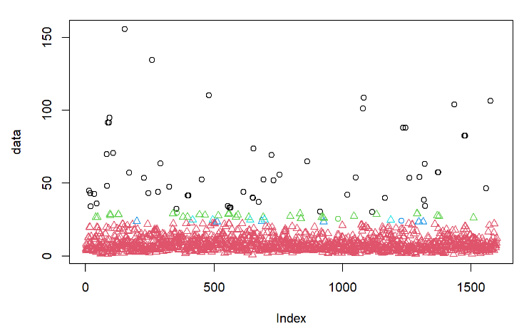
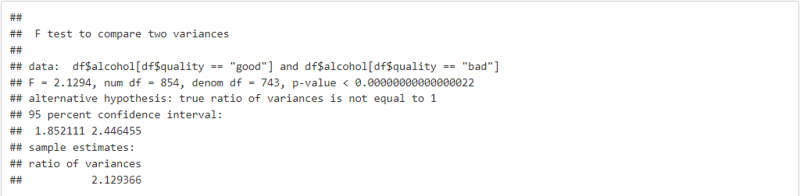
Mean & Variance Analysis
Multivariate Analysis: Correlation Plot

Slide 14
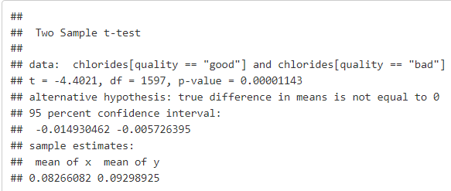
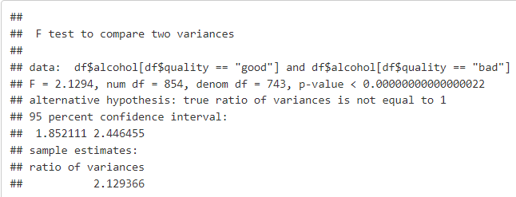
Scaling data again to improve:

Slide 15
Models Used
Principal Component Analysis
Factor / Component Analysis
Cluster Analysis
Logistic Regression
Linear Discriminant Analysis

Slide 16
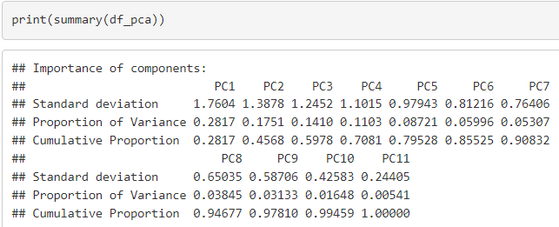
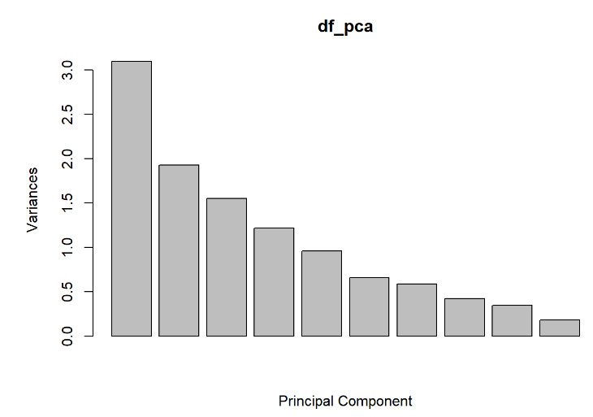
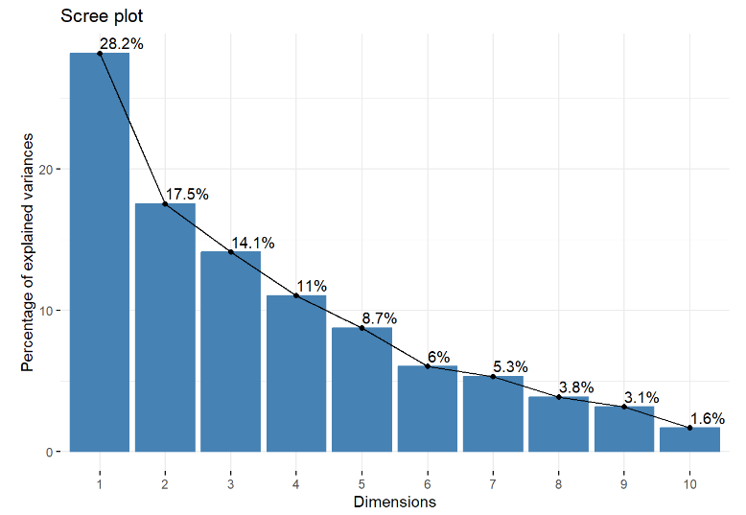
Principal Component Analysis

Slide 17
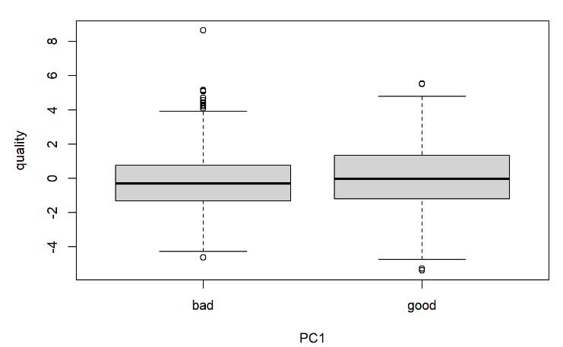
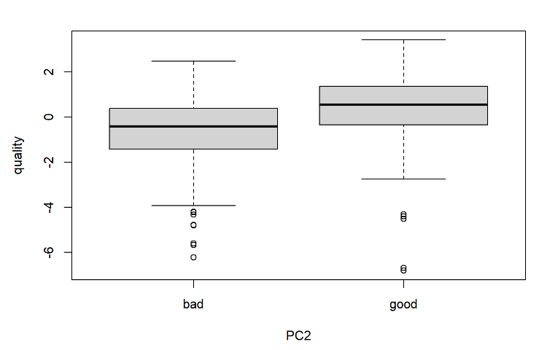
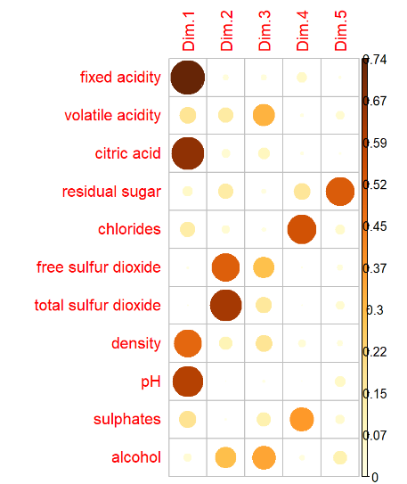
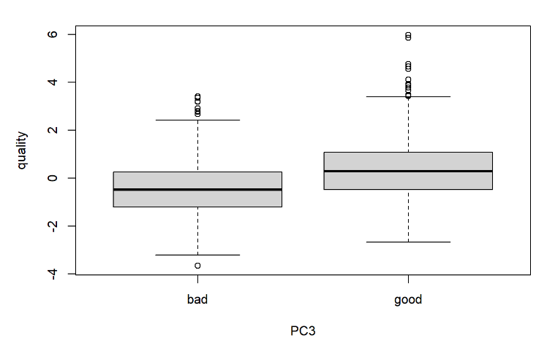
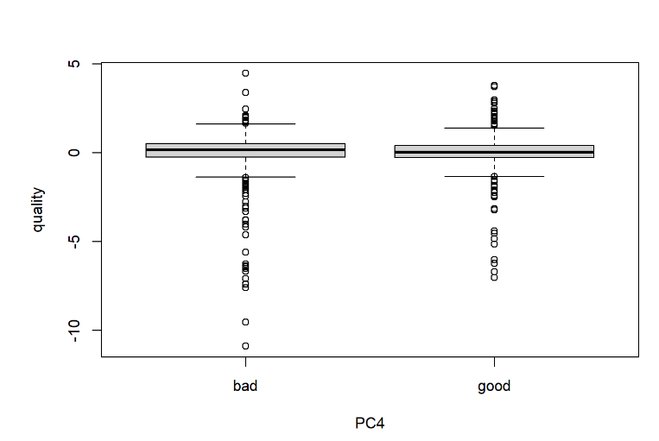
Principal Component Analysis

Slide 18
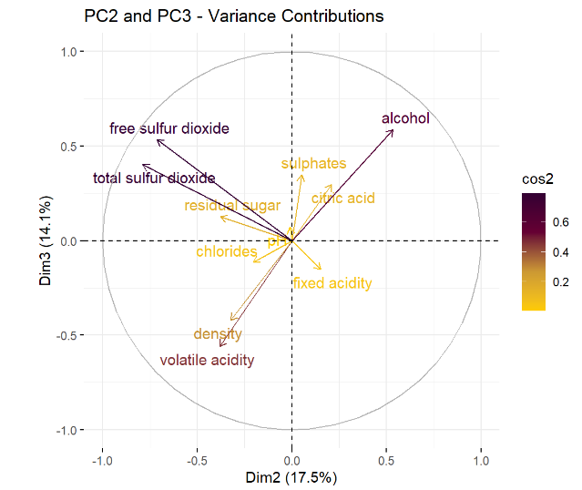
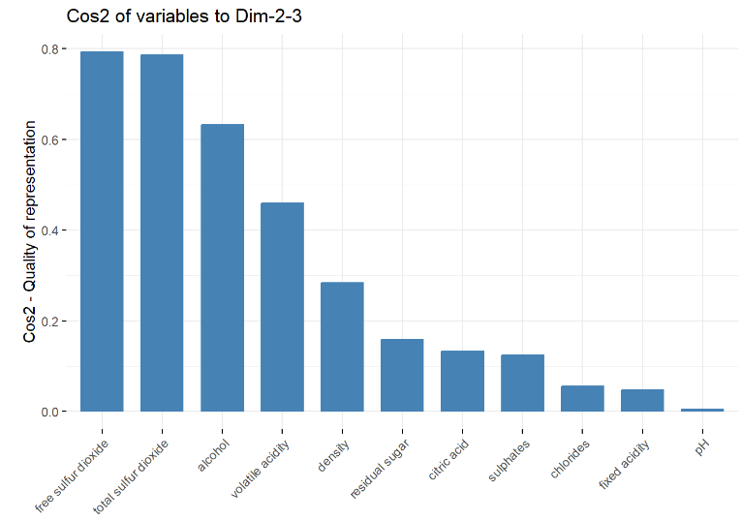
Principal Component Analysis

Slide 19
Principal Component Analysis

Slide 20
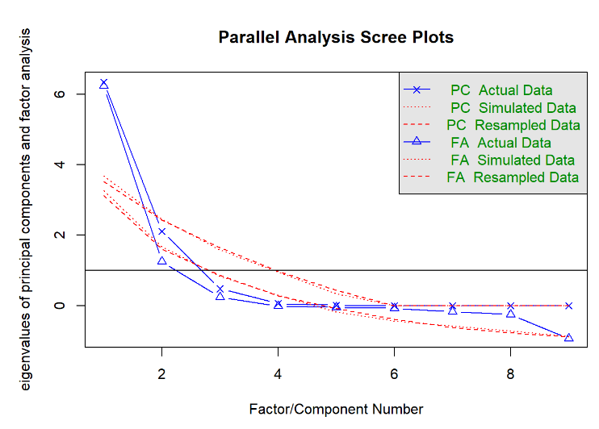
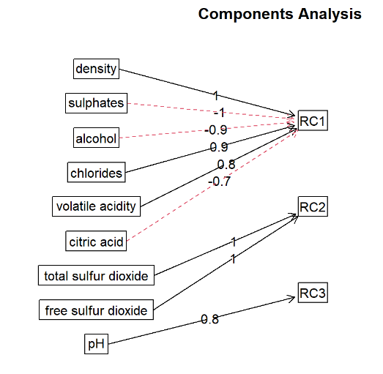
Factor / Component Analysis

Slide 21
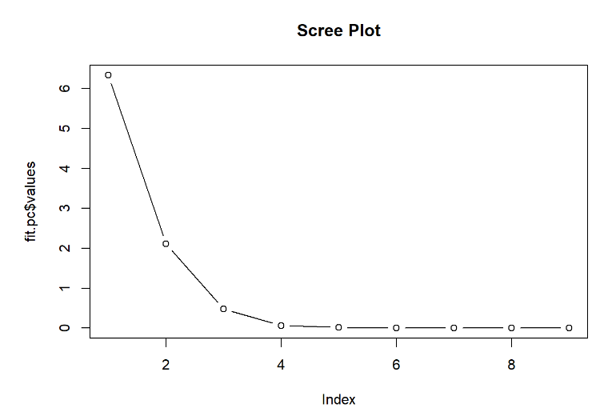
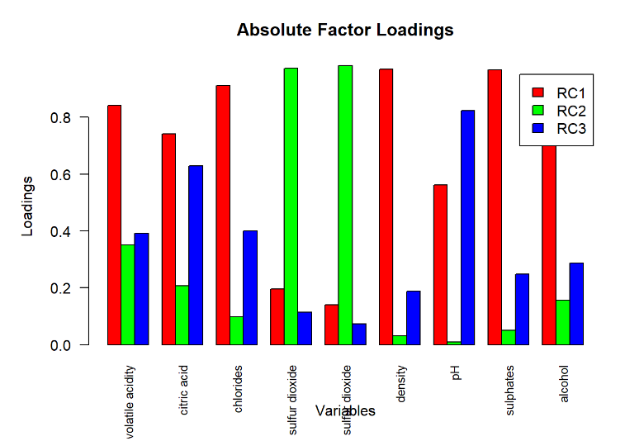
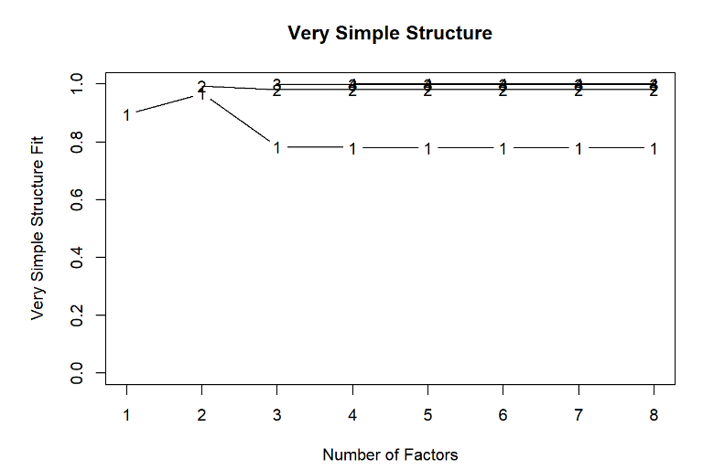
Factor / Component Analysis

Slide 22
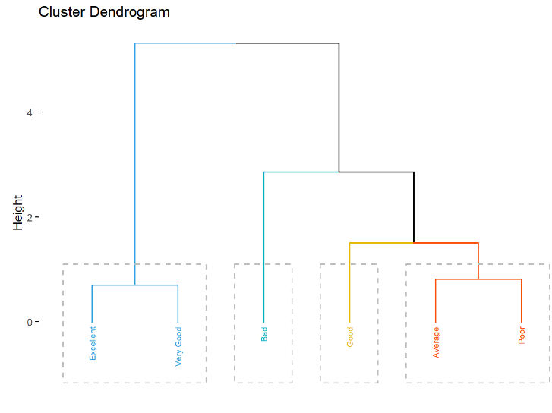
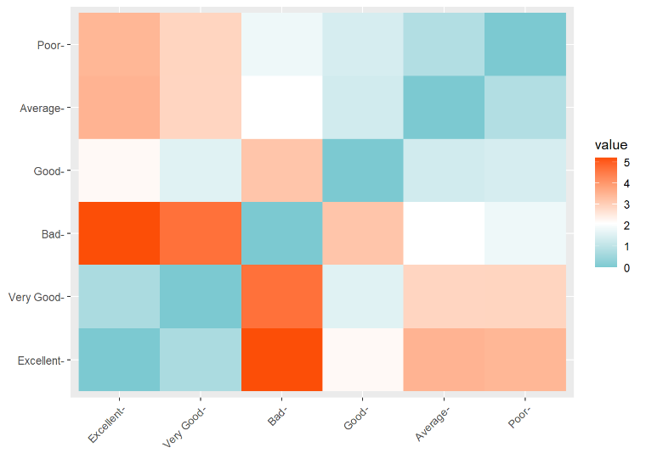
Cluster Analysis

Slide 23
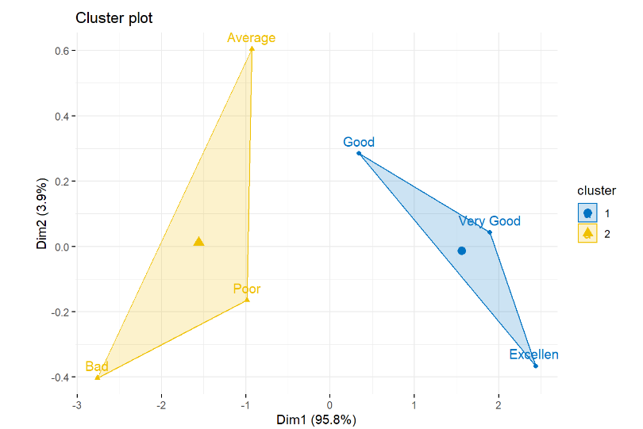
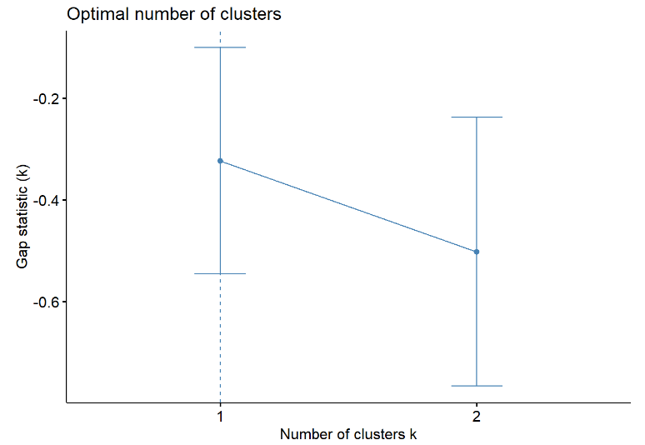
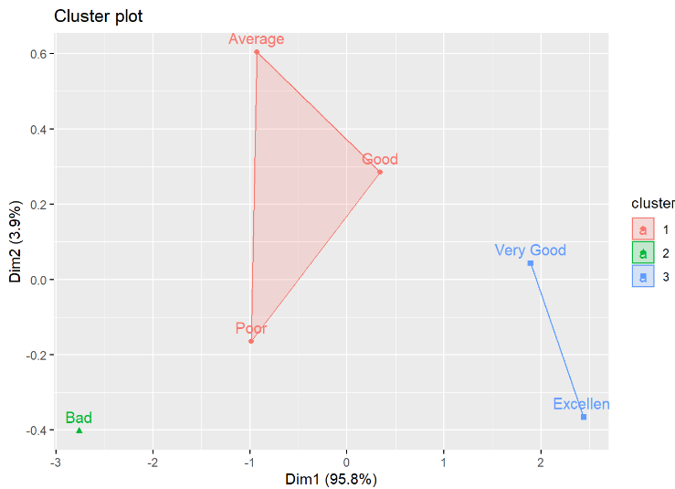
Cluster Analysis

Slide 24
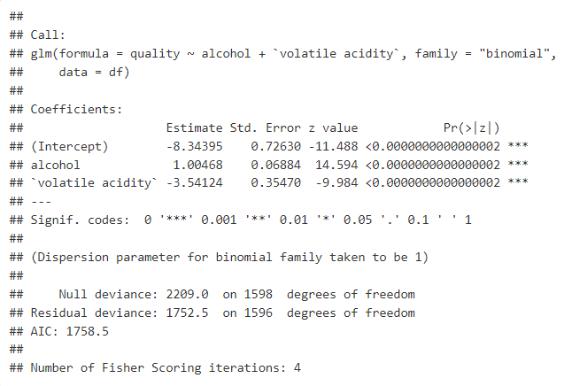
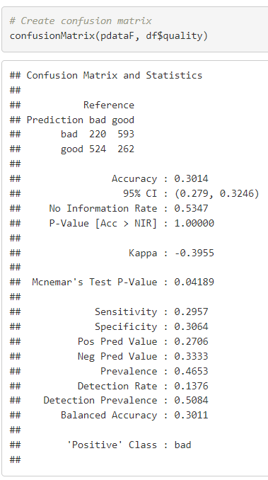
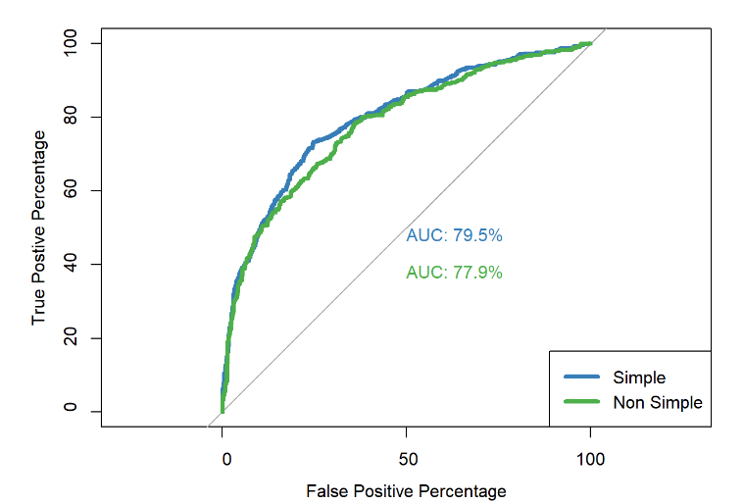
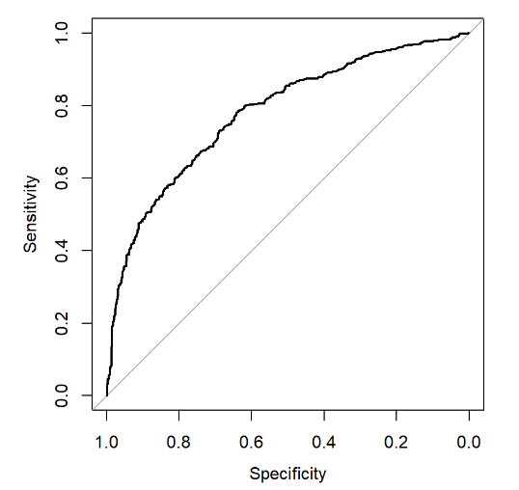
Logistic Regression

Slide 25
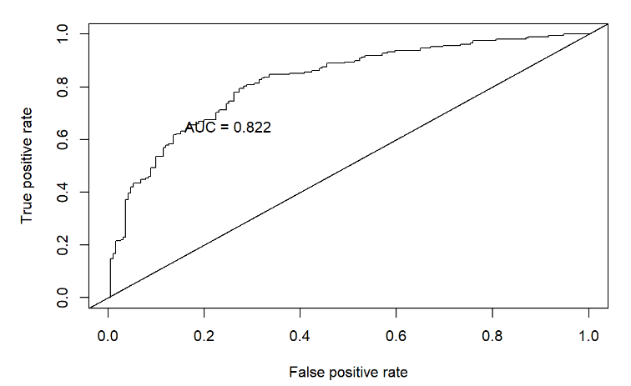
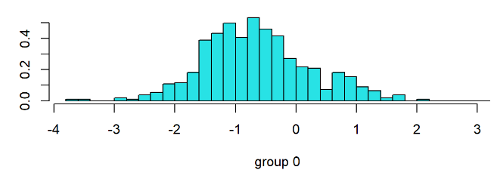
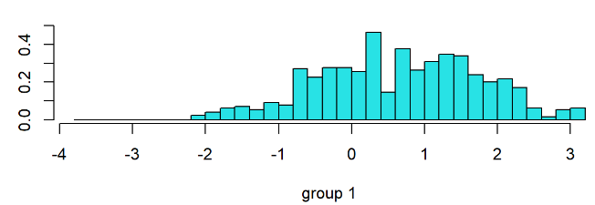
LDA

Slide 26
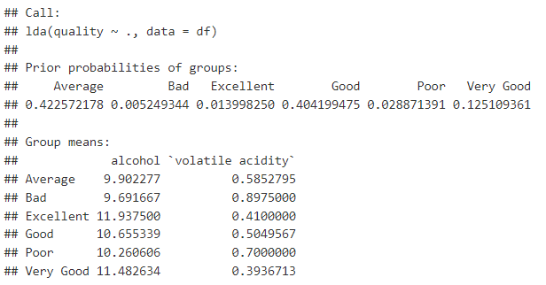
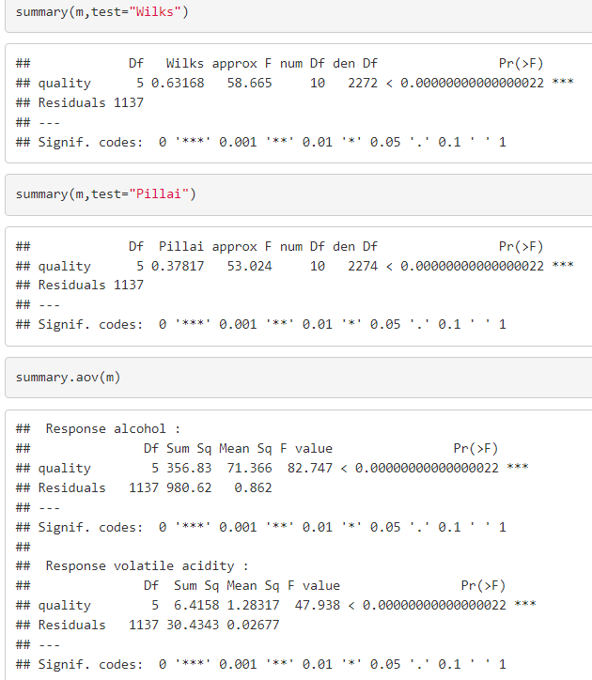
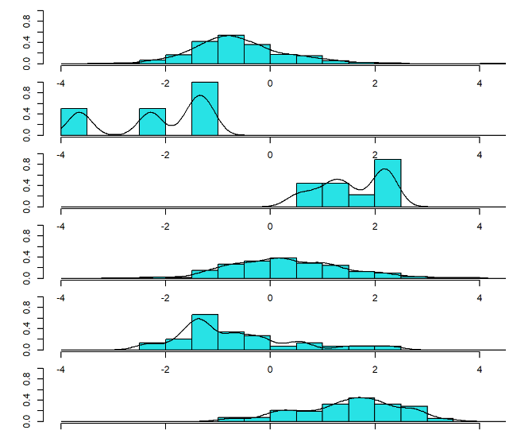
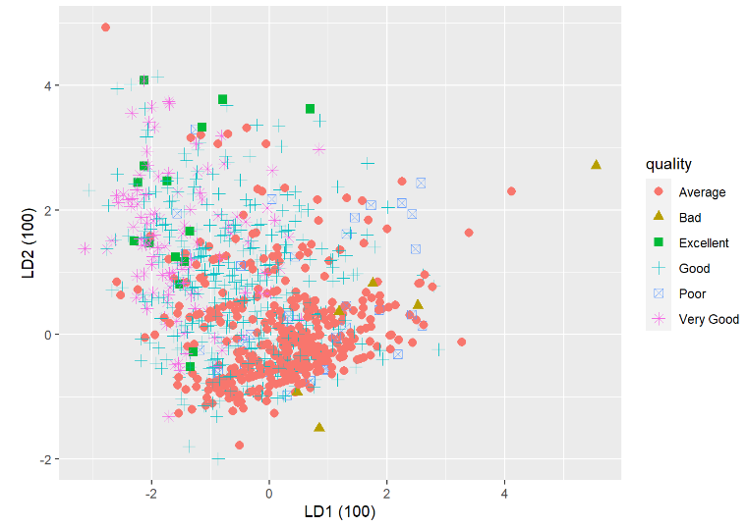
LDA

Slide 27
Conclusion
Alcohol: Seems to have a positive association with wine quality, indicating that higher alcohol content might correlate with better perceived quality.
Sulphates: There's a slight positive link with quality, suggesting sulphates, which are often related to the fermentation process, may play a role in enhancing quality.
Citric Acid: Shows a weak positive relationship, which could mean a slight contribution to the wine’s freshness and flavor complexity, factors that can be appreciated in quality wines.
Total Sulfur Dioxide: Shows a very low positive correlation, indicating it doesn’t have a strong effect on quality. Sulfur dioxide is used as a preservative and its impact on quality may not be directly perceived.
Density: Appears to have a negative relationship with quality, perhaps because higher density could be associated with wines that are less favored.
Volatile Acidity: Displays a negative association with quality, which is consistent with the fact that high levels of volatile acidity can lead to undesirable tastes and smells.
Fixed Acidity: It seems to have a slight negative correlation with quality, suggesting that too much fixed acidity might not be favorable for wine quality.
pH: The correlation with quality is minimal, implying pH level, which measures acidity, may not be a strong indicator of quality in this dataset.

Slide 28
Future Scope
Collect more sample of wine data with more attributes and occurrences from industrial platforms and provide better analysis of wine quality to wine producers.
Deploy better models to dive deep and optimize following algorithms and discover new insights for industrial purpose.

